Slide 1
Overview of Java
Chapter 2

Slide 2
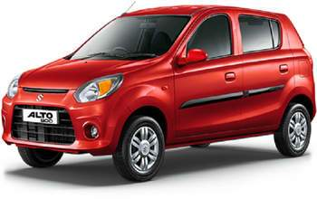
Abstraction
the process of removing physical, spatial, or temporal details or attributes during the study of objects or systems. (Also called generalization;)
Notes:
Making coffee with a coffee machine is a good example of abstraction.
You need to know how to use your coffee machine to make coffee.
You need to provide water and coffee beans, switch it on and select the kind of coffee you want to get.

Slide 3
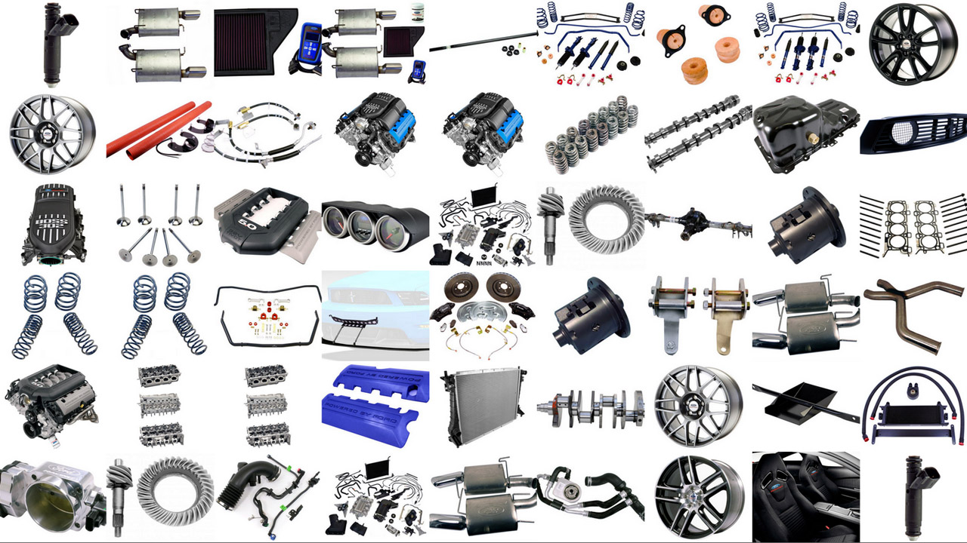
Abstraction
the process of removing physical, spatial, or temporal details or attributes during the study of objects or systems. (Also called generalization;)
Notes:
Making coffee with a coffee machine is a good example of abstraction.
You need to know how to use your coffee machine to make coffee.
You need to provide water and coffee beans, switch it on and select the kind of coffee you want to get.

Slide 4
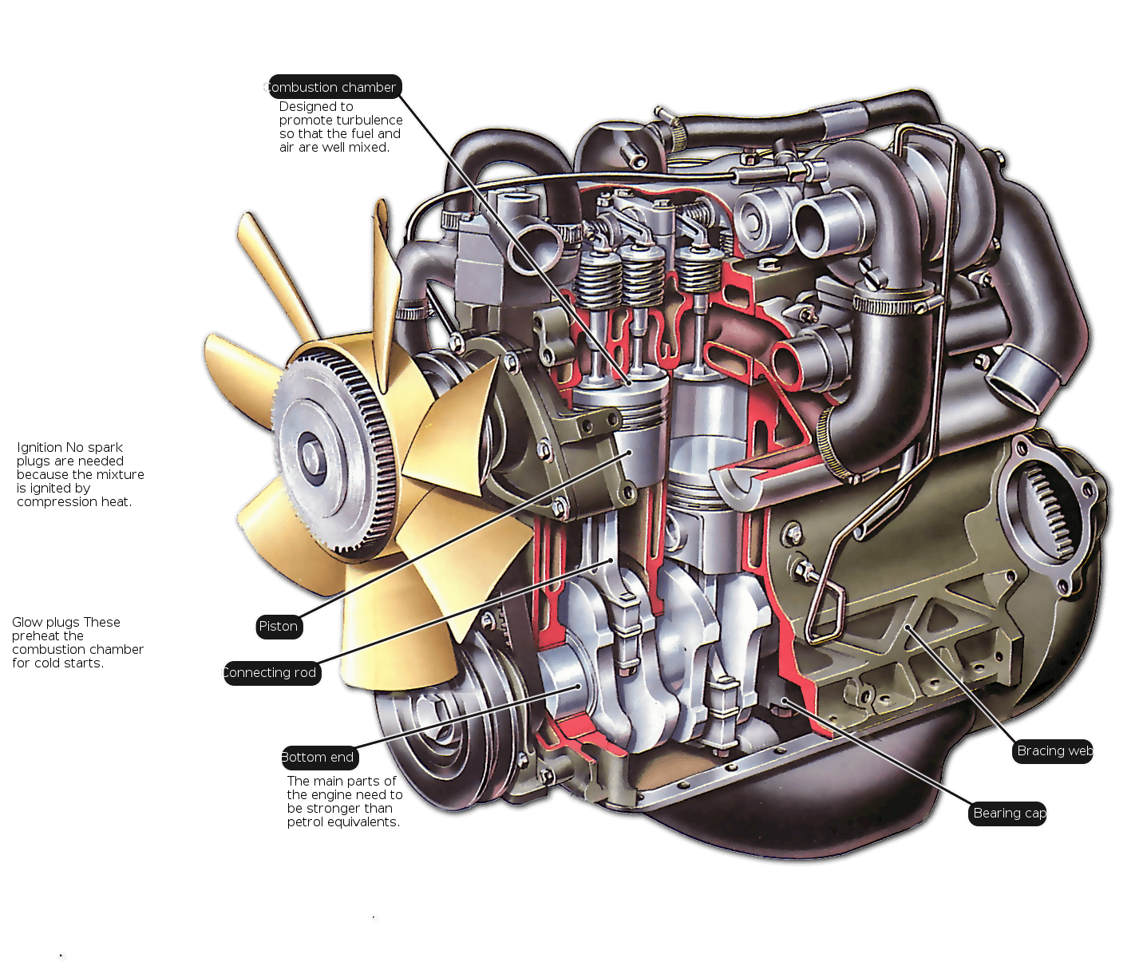
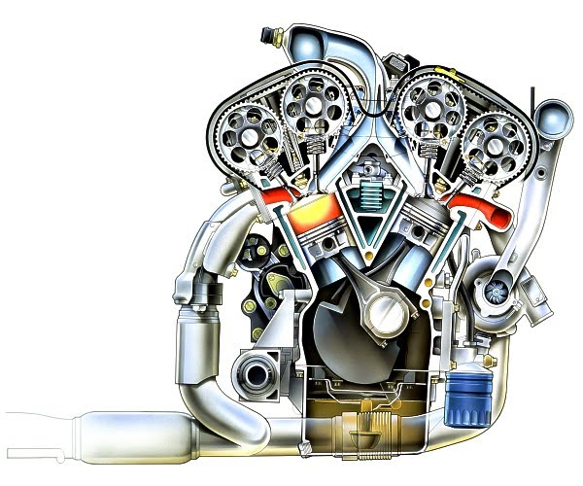

Slide 5
The Three OOP Principles
Encapsulation
Inheritance
Polymorphism

Slide 6
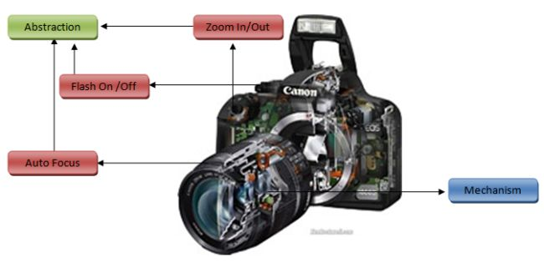
Encapsulation
Encapsulation is the mechanism that binds together code and the data it manipulates, and keeps both safe from outside interference and misuse

Slide 7
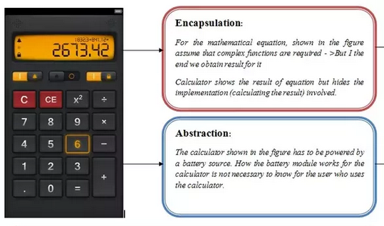
Encapsulation
The power of encapsulated code is that everyone knows how to access it and thus can use it regardless of the implementation details—and without fear of unexpected side effects
Encapsulation is the mechanism that binds together code and the data it manipulates, and keeps both safe from outside interference and misuse

Slide 8
Encapsulation
In Java, the basis of encapsulation is the class
A class defines the structure and behaviour (data and code) that will be shared by a set of objects
When you create a class, you will specify the code and data that constitute that class. They are called members of the class.
the data defined by the class are referred to as member variables or instance variables.
The code that operates on that data is referred to as member methods or just methods
Each method or variable in a class may be marked private or public
The public interface of a class represents everything that external users of the class need to know

Slide 9
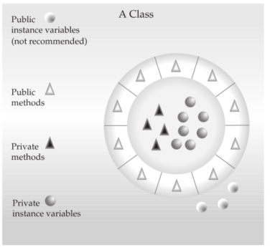
Encapsulation

Slide 10
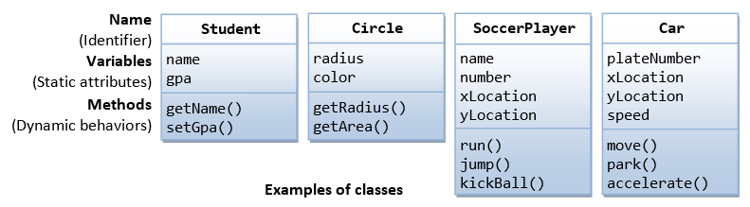
Encapsulation

Slide 11
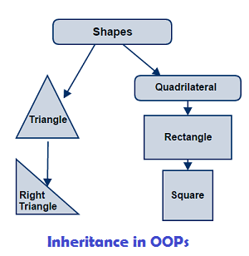
Inheritance
Inheritance is the process by which one object acquires the properties of another object.

Slide 12
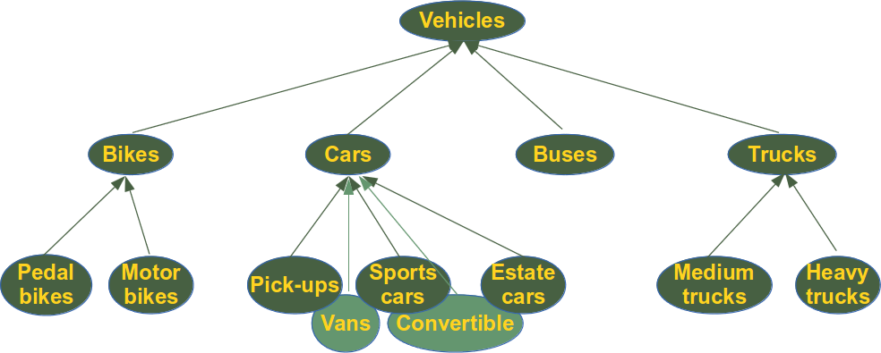
Inheritance
Inheritance is the process by which one object acquires the properties of another object.

Slide 13
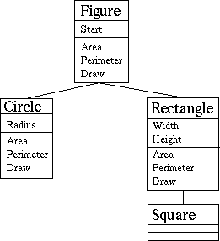
Inheritance
Inheritance is the process by which one object acquires the properties of another object.
Notes:
Use Calculator analogy calculator[add, subtract] advanced Calculator

Slide 14
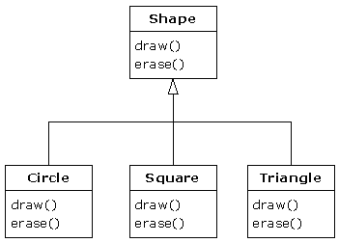
Polymorphism
Polymorphism (from Greek, meaning “many forms”) is a feature that allows one interface to be used for a general class of actions

Slide 15
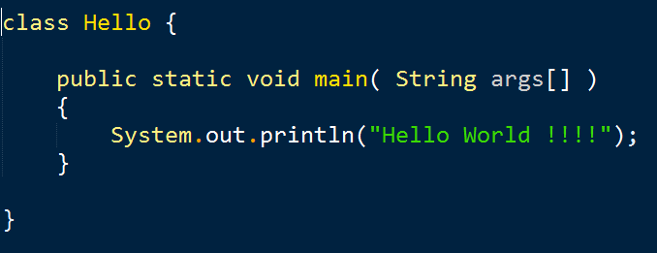
A first Simple program
Compilation : Demo
Execution : Demo
Notes:
The public keyword is an access specifier
The keyword static allows main( ) to be called without having to instantiate a particular instance of the class
main( ) is the method called when a Java application begins
String args[ ] declares a parameter named args

Slide 16
A first Simple program
Compilation :
Execution : Demo

Slide 17
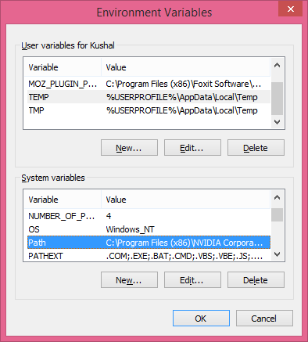
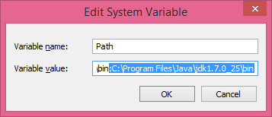
Adding java to system path for easier compilation

Slide 18
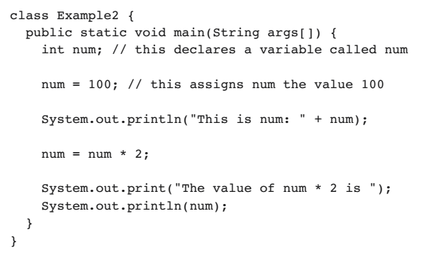
2nd Simple program
Compilation :
Execution :
Notes:
Show the use of “+” as concatenation operator

Slide 19
System
in
(InputStream)
out
(PrintStream)
err
(PrintStream)
print()
println()
printf()
write()
…
Notes:
System is a built-in class present in java.lang package. This class has a final modifier, it cannot be inherited by other classes.
Contains pre-defined methods and fields for standard input, output.
out is a static final field (ie, variable)in System class

Slide 20
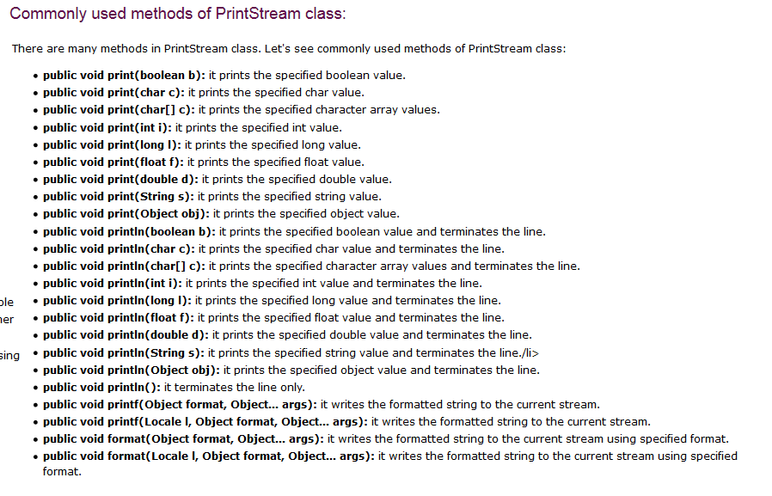

Slide 21
java doc download (60 MB approx.)
http://www.oracle.com/technetwork/java/javase/documentation/java-se-7-doc-download-435117.html

Slide 22
Example of Console output using println() and printf()

Slide 23
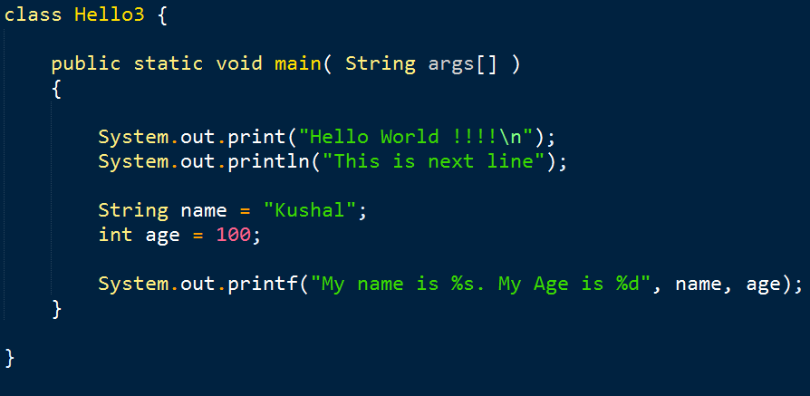
Example of Console output using printf()

Slide 24
Example of console Input

Slide 25
the Scanner class
public Scanner(InputStream source)
Scanner class is used to read input from the keyboard/file
The Scanner class breaks the input into tokens using a delimiter which is whitespace by default.
java
util
Scanner

Slide 26
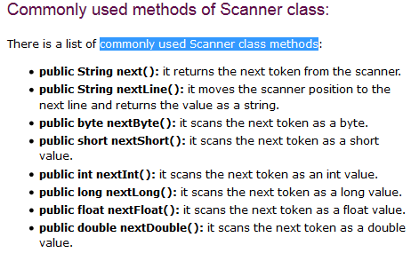

Slide 27
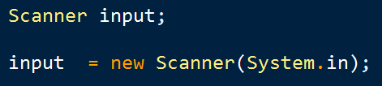
Initialization of Scanner class
public Scanner(InputStream source)
or
InputStream

Slide 28
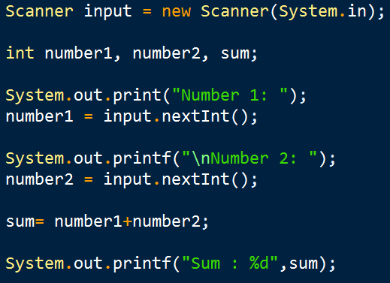
Example of sample input

Slide 29
The Java class library
Predefined “Standard” java class
Some are automatically included in each java program like (System Class)
Java provide built in class library that provide support for
I/O
String Handling
Networking
Graphics
Graphical User Interface (GUI)
Organized into Packages

